Slide 1
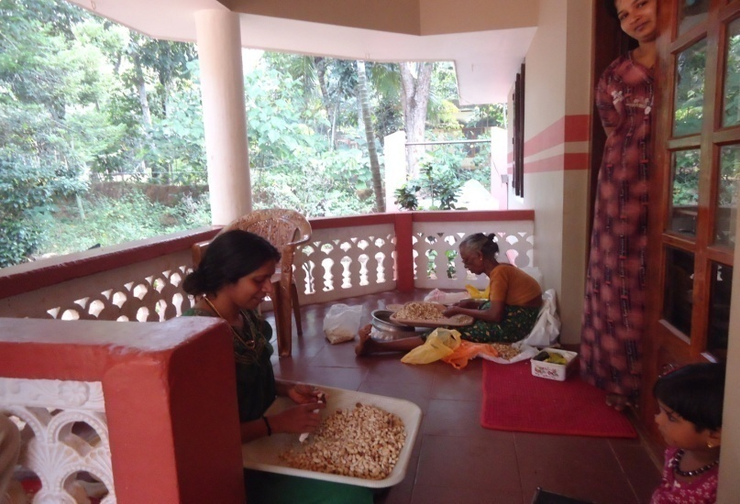
Informal /Home-based Processing

Slide 2
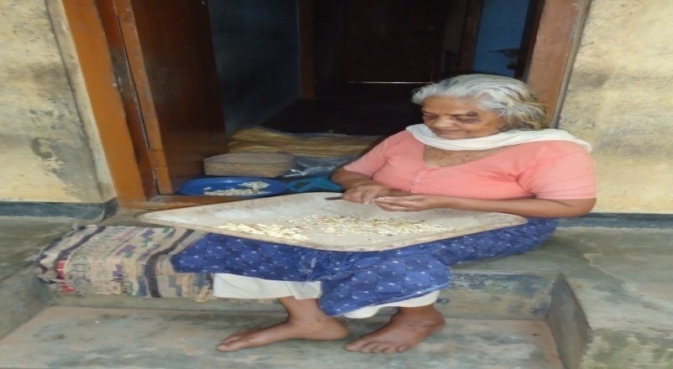
Informal /Home-based Processing

Slide 3
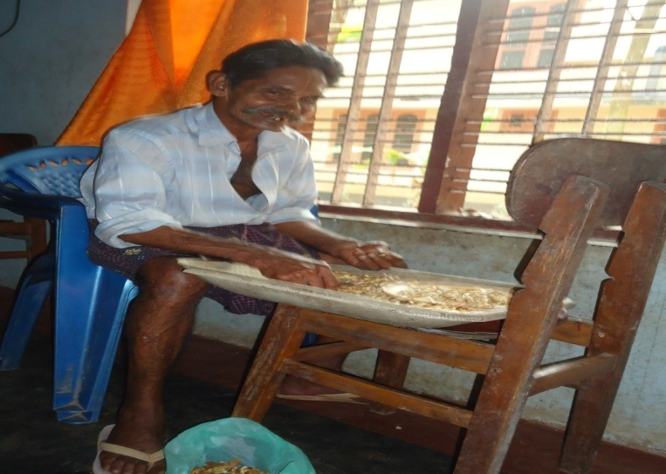
Informal /Home-based Processing

